Slide 1
Biweekly Meeting for RL Based Truck&Trailer Project
Feb 21st 2023

Slide 2
Recently Updates
Revise the randomly generation of training maps
Conduct Experiments on different Reward function and constraint
Finish the 3D modeling of Truck Trailer
Embed speed profile in reward function

Slide 3
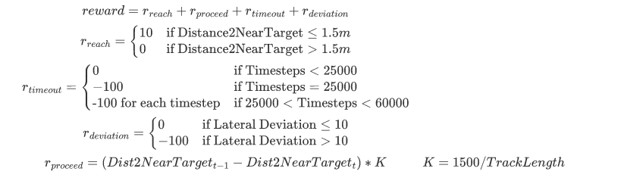
Reward function revision

Slide 4
Training Results of different reward and constraint
file ID | learning rate | entropy_value | k_value | reward_reach | reward_timeout | reward_deviate | Terminate time | penalty_time |  | result
1 | 3.00E-05 | 1.00E-03 | 1500/dist | 10 | -100 | -100 | 25000 | 20000 | soft | fail
2 | 3.00E-05 | 1.00E-03 | 1500/dist | 10 | -100 | -100 | 20000 | 20000 | hard
3 | 3.00E-05 | 1.00E-03 | 1800/dist | 15 | -100 | -100 | 25000 | 20000 | soft | fail
4 | 3.00E-05 | 1.00E-03 | 1800/dist | 10 | -100 | -100 | 20000 | 20000 | hard | fail

Slide 5
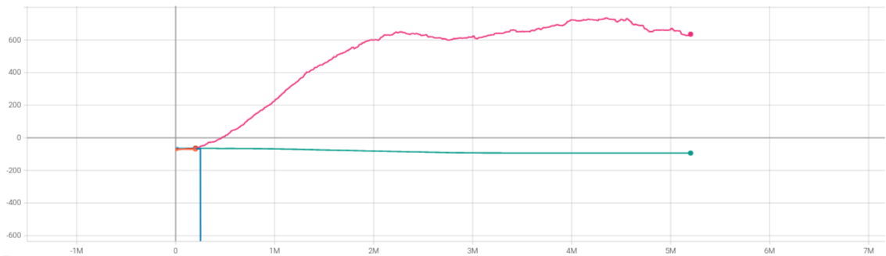
Training Results of different reward and constraint
Reward

Slide 6
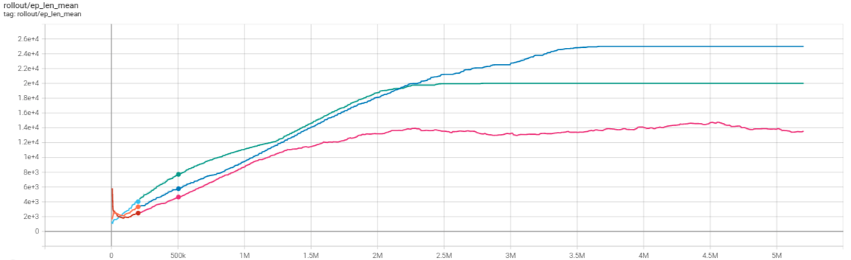
Training Results of different reward and constraint
Time Steps

Slide 7
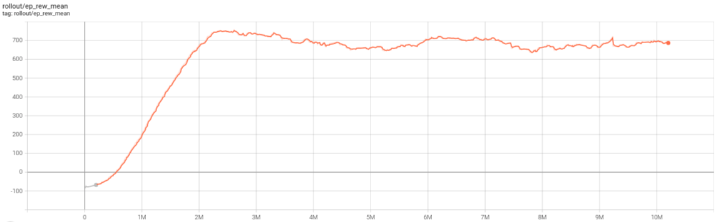
Converged Model
pre0217.mp4 (sharepoint.com)

Slide 8
Performance of previous model
oldmodel.mp4 (sharepoint.com)

Slide 9
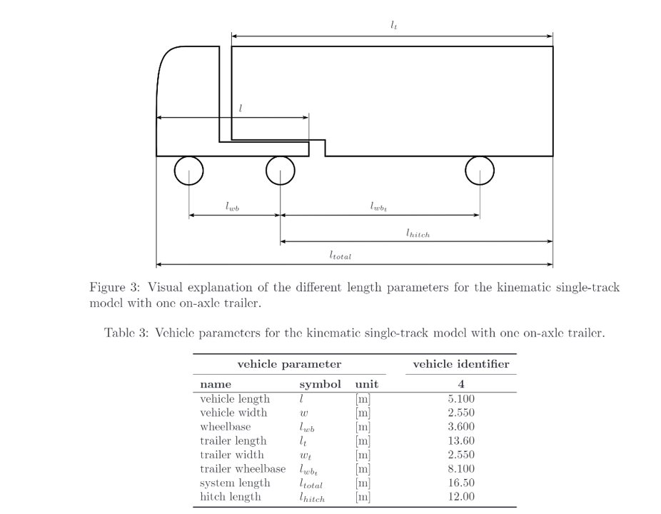
Truck Trailer model

Slide 10

Truck Trailer model

Slide 11
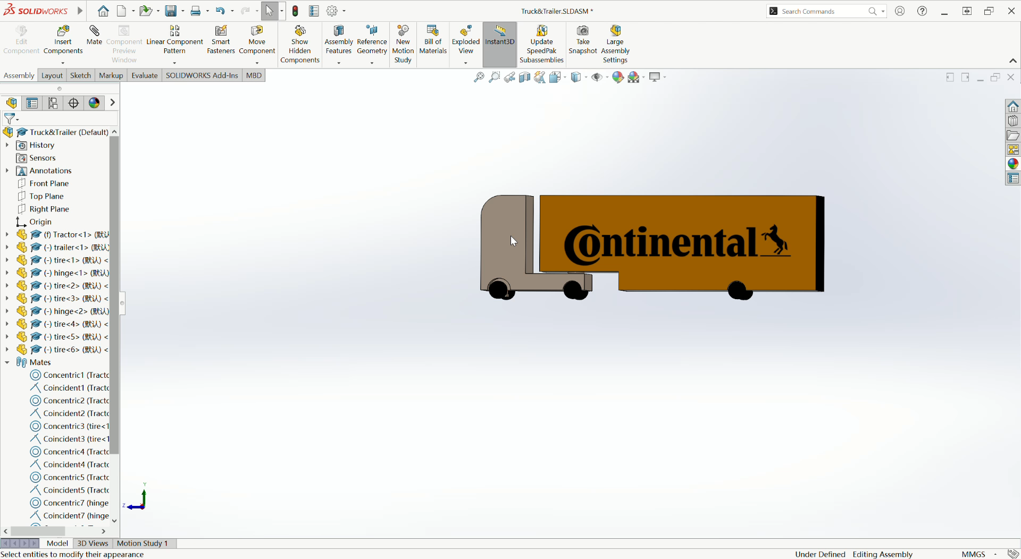

Slide 12
Plans for next two week
Finish the transformation of truck model from sw to urdf
Conduct more experiments to make the policy robust
Implement speed profile into reward function and run test
Finish the training environment of Truck Trailer model and conduct initial training

